Slide 1

Reactive applications with Vert.x
Bartosz Malinowski
bartoszmichalmalinowski@gmail.com
https://github.com/bbmall

Slide 2
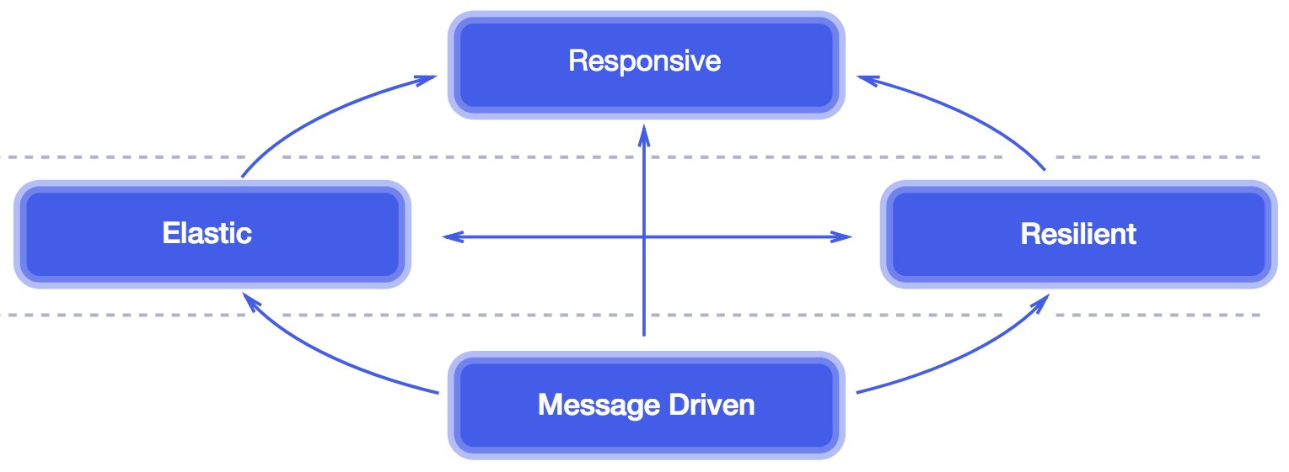
Reactive systems Reactive manifesto
Reference: https://www.reactivemanifesto.org

Slide 3
Reactive programming
Non-blocking event driven
Solves callback hell problem
Stream of events
Doesn’t fit everywhere

Slide 4
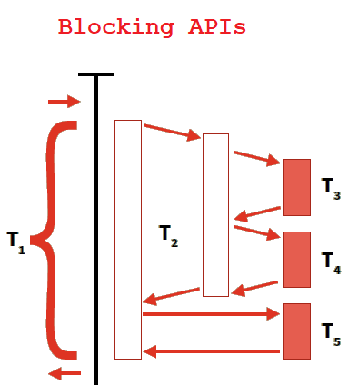
Non-blocking code

Slide 5
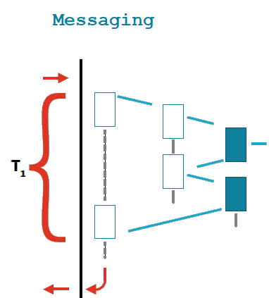
Non-blocking code

Slide 6
Reactive programming
Non-blocking event driven
Solves callback hell problem
Stream of events
Doesn’t fit everywhere

Slide 7
Problem – callback hell
serviceA.getA(data, function (respA) {
serviceB.getB(respA, function (respB) {
serviceC.getC(respB, function (respC) {
serviceD.getD(respC, function (respD) {
doSomething(respD);
});
});
});
});

Slide 8
Solution
serviceA.getA(data)
.concatMap(respA -> serviceB.getB(respA))
.concatMap(respB -> serviceC.getC(respB))
.concatMap(respC -> serviceD.getD(respC))
.subscribe(respD -> doSomething(respD));

Slide 9
Reactive programming
Non-blocking event driven
Solves callback hell problem
Stream of events
Doesn’t fit everywhere

Slide 10
Stream of events
Observable o = Observable.from(serviceA.getA(data.id));
o.flatMap(respA -> serviceB.apply(respA))
.map(respB -> transformIntoC(respB))
.filter(respC -> checkData(respC))
.subscribe(respC -> println("We have C! " + respC));

Slide 11
Reactive programming
Non-blocking event driven
Solves callback hell problem
Stream of events
Doesn’t fit everywhere

Slide 12
Vert.x
JVM application framework
Inspiration from Node.js – non blocking and asynchronous
Polyglot (Java, JavaScript, Groovy, Ruby, Ceylon, Scala and Kotlin)
Very high performance
Lightweight

Slide 13
Spring Boot vs Vert.x demo
Responsiveness in synchronous and asynchronous http server

Slide 14
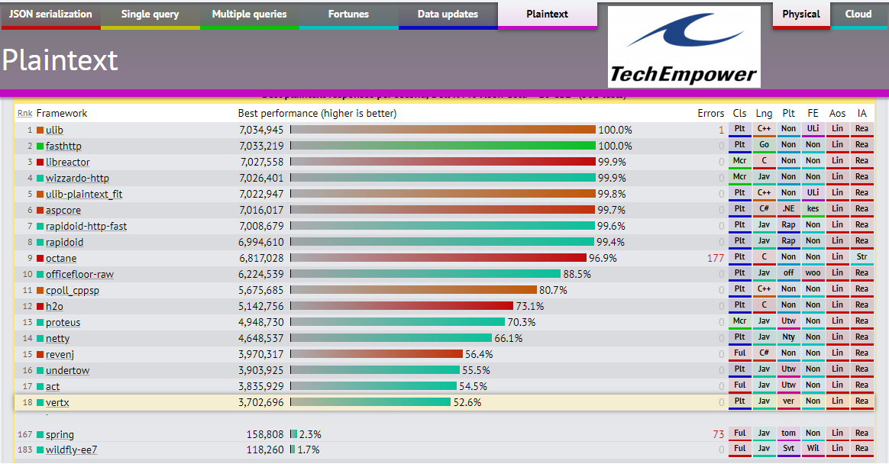

Slide 15
Core asynchronous APIs
Is small and lightweight
TCP/SSL clients & servers
HTTP/HTTPS clients and servers
Websockets
File system
Event bus
DNS
UDP
Distributed Data

Slide 16
How to write Vert.x application?

Slide 17
Verticle
Execution unit of Vert.x
Simple in deploying and scaling
Something like Actor-Model
Single threaded
Different thread pool for workers
Can be written in any language
Can be run at command line or embedded in an application
Can be run with high availability
Notes:
DEFAULT_EVENT_LOOP_POOL_SIZE = 2 * CpuCoreSensor.availableProcessors(); DEFAULT_WORKER_POOL_SIZE = 20; DEFAULT_INTERNAL_BLOCKING_POOL = 20;
DEFAULT_MAX_EVENT_LOOP_EXECUTE_TIME = 2s DEFAULT_MAX_WORKER_EXECUTE_TIME = 60s

Slide 18
Hello world with Vert.x - demo
Simple http server in Java and JS

Slide 19
Event bus
The nervous system of Vert.x
Verticles use it to communicate with each other
Same instance for all Vert.x instances in cluster
Point to point, Publish – Subscribe
Prefers to pass JSON but can use strings, buffers, primitives types
No monolithic ‘master server’
Allows to create loosely coupled components

Slide 20
Event bus in the browser
Can be used by JavaScript too
Uses the same API on the client
Great for creating “real-time” web applications

Slide 21
Event-bus - demo
Communication between 2 java verticles and a verticle with client (JS)

Slide 22
Other components
Web
Data access
mongoDB, jdbc, sql, redis, mySql, PostgreSQL, Cassandra
Reactive
Vert.x Rx, Reactive streams, Kotlin coroutines
Microservice
service discovery, circuit breaker
MQTT
Authentication and Authorization
Auth common, JDBC auth, JWT auth, Shiro auth, MongoDB auth, OAuth 2
Notes:
ORACLE - Asynchronous Database Access API (ADBA)
TESTY: toolkit Vert.x-Unit + Vert.x-JUnit5

Slide 23
Other components
Integration
Mail Client, Consul Client, RabbitMQ Client, Kafka Client, JCA Adaptor, AMQP Bridge
Event Bus Bridge
TCP Eventbus Bridge
Camel Bridge
Devops
Dropwizard, Micrometer, Vert.x Health Check, Shell, Docker, Stack Manager
Cloud - OpenShift 3
Clustering
Hazelcast, Infinispan, Apache Zookeeper, Apache Ignite

Slide 24



















Who uses Vert.x?

Slide 25
Summary
Verticles
Event bus
Polyglot
Simple concurrency
Components can live anywhere and be connected as single cluster
Very fast even with data-access (uses reactive-pg-client)
Allows to create reactive systems
Uses reactive programming
Doesn’t fit everywhere ¯\_(ツ)_/¯

Slide 26
Links
https://vertx.io
https://github.com/vert-x3/vertx-examples
https://www.reactivemanifesto.org
https://www.techempower.com/benchmarks/#section=data-r17&hw=cl&test=plaintext&l=l84xs-0
https://dreamix.eu/blog/java/reactive-java-vert-x-vs-spring-framework-5

Slide 27
Q&A

